Slide 1
5.1 Levels of Representation and Curatorial Implications
Christopher (Cal) Lee
callee@ils.unc.edu
September 13, 2016
Open Source Enterprise
Reston, VA, USA
September 7-20, 2016

Slide 2
Outline
Issues of Preserving Meaningful Information
Nature of Digital Objects
Layers and Abstraction
Technology Obsolescence
Significant Properties
Technical Strategies
Concluding Thoughts on Preservation
Access and Use Considerations

Slide 3
The Hermeneutic Gap
All conveying of memory (even to ourselves) runs into a hermeneutic gap.
Context is never captured or perpetuated completely.
We use current understanding & place in the world to fill in gaps of previous contexts in order to make sense of memories.
This is one of our greatest strengths as humans but also raises many issues related to concepts we cherish (e.g. truth, tradition, accuracy, accountability).

Slide 4
Bridging the Gap (Sort of)
Information professionals work to bridge the gap through:
adding metadata into the system (filing cabinets, policies) & at point of creation (naming, filing, genre conventions)
selection
retention scheduling
disposition actions
transfer of custody to trusted third parties
labor-intensive arrangement & description
controlled custody environments
one-on-one reference services

Slide 5
Resources are Limited, Meaning is Expensive
Always true, but increasingly important in a digital environment
Two often competing demands:
more heterogeneous access (any type of client can access any type of object)
more functionality (each object becomes increasingly complex, thus carrying more dependencies)

Slide 6
High
Most expensive
Richness and internal complexity of meaning being conveyed
Least expensive
Low
High
Difference between contexts
Lee, Christopher A. “Digital Curation as Communication Mediation.” In Handbook of Technical Communication, edited by Alexander Mehler, Laurent Romary, and Dafydd Gibbon, 507-530. Berlin: Mouton De Gruyter, 2012.

Slide 7
Not just the Final Product:
“…disseminated analytic products must contain consistent and structured sourcing information for all significant and substantive reporting or other information upon which the product's analytic judgments, assessments, estimates, or confidence levels depend. Thorough and consistent documentation enhances the credibility and transparency of intelligence analysis and enables consumers to better understand the quantity and quality of information underlying the analysis.”
Intelligence Community Directive Number 206. “Sourcing Requirements For Disseminated Analytic Products.” Effective: October 17, 2007. (Emphasis Added)

Slide 8
Bits will be Bits (But not for Long)
Physical media should be stored in appropriate environmental conditions.
Take care in handling of media.
Maintain integrity of bit stream through security, checksums, periodic sampling & other validation
Bit rot & advantages of newer media both call for periodic refresh & reformatting.
Ensuring the integrity of the bit stream in such transfers is extremely important.

Slide 9
Digital objects are sets of instructions for future interaction
Digital objects are useless (& don’t even exist) if no one can interact with them
Interactions depend on numerous technical components
Only a small part of preservation work is about treating them like physical artifacts.
Rothenberg takes this even farther, contending that all digital objects should be seen as programs.

Slide 10
Layers and Abstraction
"Computer science is largely a matter of abstraction: identifying a wide range of applications that include some overlapping functionality, and then working to abstract out that shared functionality into a distinct service layer (or module, or language, or whatever). That new service layer then becomes a platform on top of which many other functionalities can be built that had previously been impractical or even unimagined. How does this activity of abstraction work as a practical matter? It's technical work, of course, but it's also social work. It is unlikely that any one computer scientist will be an expert in every one of the important applications areas that may benefit from the abstract service. So collaboration will be required.” (emphasis added) - Phil Agre, Red Rock Eater, March 25, 2000

Slide 11
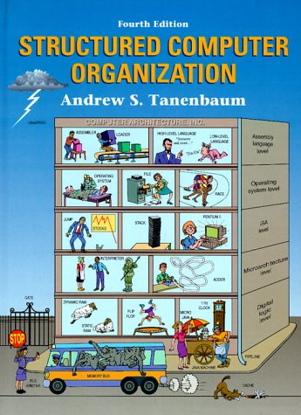
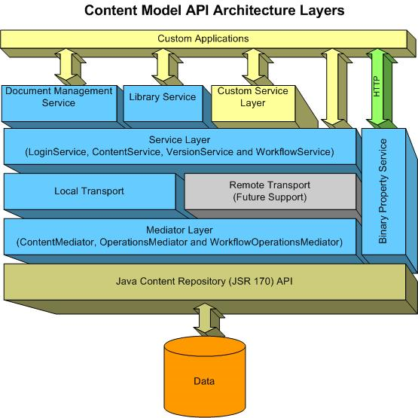
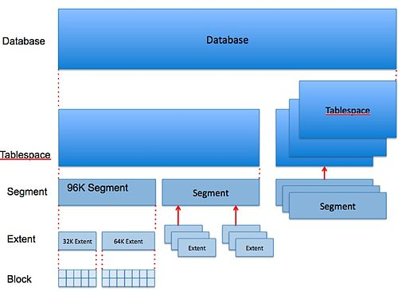
Layers, Layers Everywhere
http://www.ibm.com/developerworks/websphere/techjournal/0607_kubik/0607_kubik.html
http://upload.wikimedia.org/wikipedia/commons/thumb/c/c7/Oracle_Storage_Hierarchy.jpg/500px-Oracle_Storage_Hierarchy.jpg

Slide 12
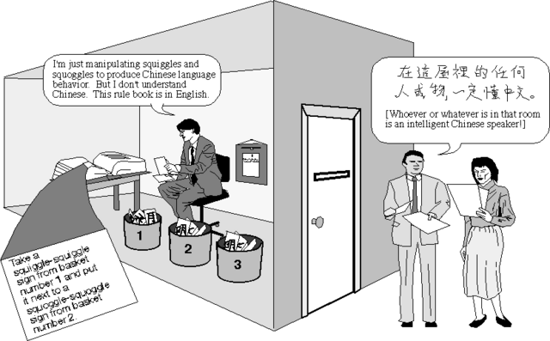
John Searle’s “Chinese Room” – An Input-Output Scenario Involving Abstraction
Source: MacroVU, Inc. Mapping Great Debates: Can Computers Think? http://www.macrovu.com/CCTMap4ChineseRm.html

Slide 13
What levels are most relevant to digital curation? See: Lee, Christopher A. “Digital Curation as Communication Mediation.” In Handbook of Technical Communication, edited by Alexander Mehler, Laurent Romary, and Dafydd Gibbon, 507-530. Berlin: Mouton De Gruyter, 2012.

Slide 14
Digital Resources - Levels of Representation
Level | Label | Explanation
8 | Aggregation of objects | Set of objects that form an aggregation that is meaningful encountered as an entity
7 | Object or package | Object composed of multiple files, each of which could also be encountered as individual files
6 | In-application rendering | As rendered and encountered within a specific application
5 | File through filesystem | Files encountered as discrete set of items with associate paths and file names
4 | File as “raw” bitstream | Bitstream encountered as a continuous series of binary values
3 | Sub-file data structure | Discrete “chunk” of data that is part of a larger file
2 | Bitstream through I/O equipment | Series of 1s and 0s as accessed from the storage media using input/output hardware and software (e.g. controllers, drivers, ports, connectors)
1 | Raw signal stream through I/O equipment | Stream of magnetic flux transitions or other analog electronic output read from the drive without yet interpreting the signal stream as a set of discrete values (i.e. not treated as a digital bitstream that can be directly read by the host computer)
0 | Bitstream on physical medium | Physical properties of the storage medium that are interpreted as bitstreams at Level 1

Slide 15
Interaction Examples
Level | Examples
Aggregation of objects | Browsing the contents of an archival collection using a finding aid
Object or package | Viewing a web page that contains several files, including HTML, a style sheet and several images
In-application rendering | Using Microsoft Excel to view an .xls file, watching an online video by using a Flash viewer
File through filesystem | Viewing contents of a folder using Windows Explorer, typing “ls” at the Unix command prompt to show the contents of a directory
File as “raw” bitstream | Opening an individual file in a hex editor
Sub-file data structure | Extracting a tagged data element in an XML document or value of a field in a relational database
Bitstream through I/O equipment | Connecting a hard drive to a host computer and then generating a sector-by-sector image of the disk using Unix dd command
Raw signal stream through I/O equipment | Connecting a floppy drive to a host computer and then generating a magnetic flux transition image of the disk
Bitstream on physical medium | Using a high-power microscope and camera to take a picture of the patterns of magnetic charges on the surface of a hard drive or pits and lands on an optical disk

Slide 16
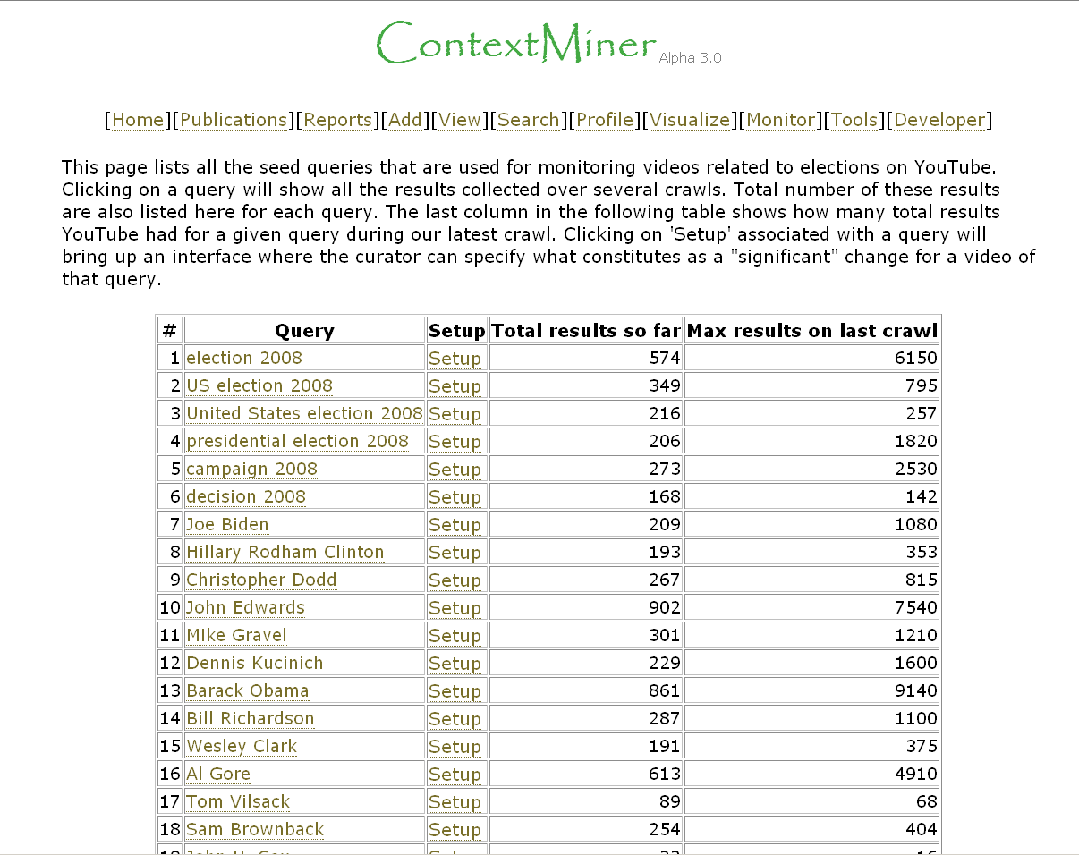
Interaction Examples
Level | Examples
Aggregation of objects | Browsing the contents of an archival collection using a finding aid
Object or package | Viewing a web page that contains several files, including HTML, a style sheet and several images
In-application rendering | Using Microsoft Excel to view an .xls file, watching an online video by using a Flash viewer
File through filesystem | Viewing contents of a folder using Windows Explorer, typing “ls” at the Unix command prompt to show the contents of a directory
File as “raw” bitstream | Opening an individual file in a hex editor
Sub-file data structure | Extracting a tagged data element in an XML document or value of a field in a relational database
Bitstream through I/O equipment | Connecting a hard drive to a host computer and then generating a sector-by-sector image of the disk using Unix dd command
Raw signal stream through I/O equipment | Connecting a floppy drive to a host computer and then generating a magnetic flux transition image of the disk
Bitstream on physical medium | Using a high-power microscope and camera to take a picture of the patterns of magnetic charges on the surface of a hard drive or pits and lands on an optical disk

Slide 17
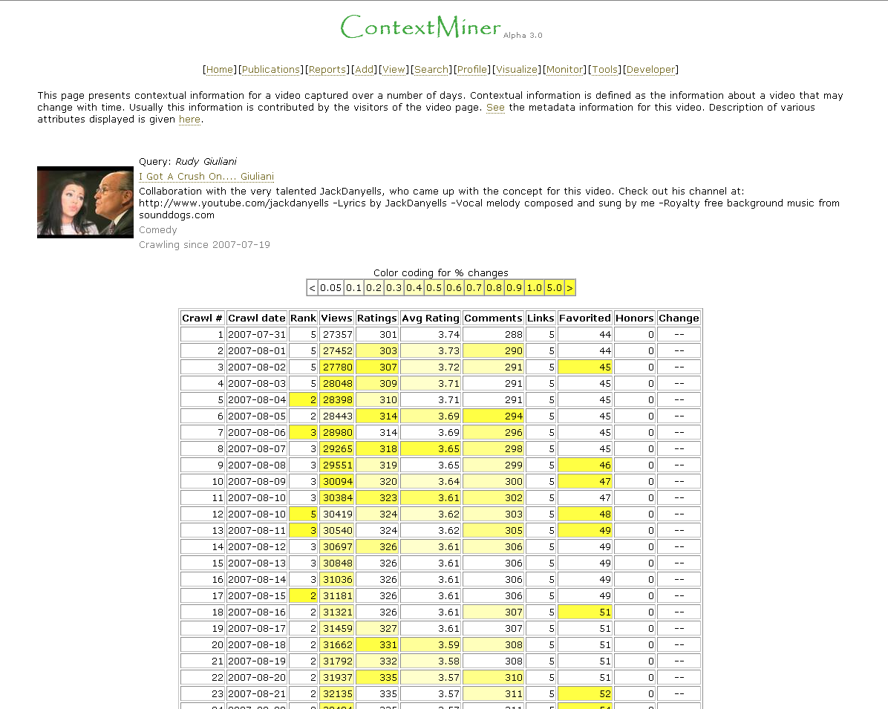
Interaction Examples
Level | Examples
Aggregation of objects | Browsing the contents of an archival collection using a finding aid
Object or package | Viewing a web page that contains several files, including HTML, a style sheet and several images
In-application rendering | Using Microsoft Excel to view an .xls file, watching an online video by using a Flash viewer
File through filesystem | Viewing contents of a folder using Windows Explorer, typing “ls” at the Unix command prompt to show the contents of a directory
File as “raw” bitstream | Opening an individual file in a hex editor
Sub-file data structure | Extracting a tagged data element in an XML document or value of a field in a relational database
Bitstream through I/O equipment | Connecting a hard drive to a host computer and then generating a sector-by-sector image of the disk using Unix dd command
Raw signal stream through I/O equipment | Connecting a floppy drive to a host computer and then generating a magnetic flux transition image of the disk
Bitstream on physical medium | Using a high-power microscope and camera to take a picture of the patterns of magnetic charges on the surface of a hard drive or pits and lands on an optical disk

Slide 18
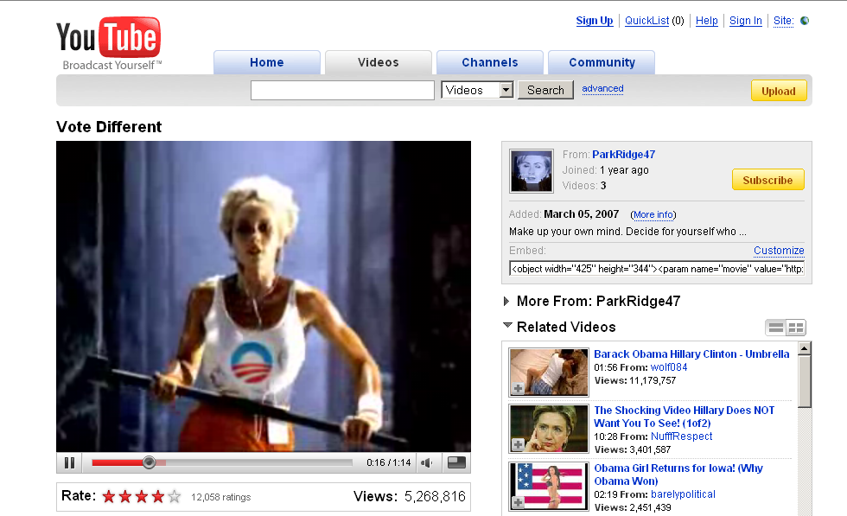
Interaction Examples
Level | Examples
Aggregation of objects | Browsing the contents of an archival collection using a finding aid
Object or package | Viewing a web page that contains several files, including HTML, a style sheet and several images
In-application rendering | Using Microsoft Excel to view an .xls file, watching an online video by using a Flash viewer
File through filesystem | Viewing contents of a folder using Windows Explorer, typing “ls” at the Unix command prompt to show the contents of a directory
File as “raw” bitstream | Opening an individual file in a hex editor
Sub-file data structure | Extracting a tagged data element in an XML document or value of a field in a relational database
Bitstream through I/O equipment | Connecting a hard drive to a host computer and then generating a sector-by-sector image of the disk using Unix dd command
Raw signal stream through I/O equipment | Connecting a floppy drive to a host computer and then generating a magnetic flux transition image of the disk
Bitstream on physical medium | Using a high-power microscope and camera to take a picture of the patterns of magnetic charges on the surface of a hard drive or pits and lands on an optical disk

Slide 19
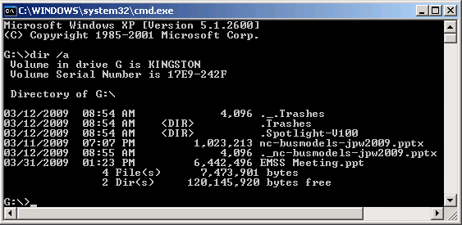
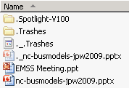
Level | Examples
Aggregation of objects | Browsing the contents of an archival collection using a finding aid
Object or package | Viewing a web page that contains several files, including HTML, a style sheet and several images
In-application rendering | Using Microsoft Excel to view an .xls file, watching an online video by using a Flash viewer
File through filesystem | Viewing contents of a folder using Windows Explorer, typing “ls” at the Unix command prompt to show the contents of a directory
File as “raw” bitstream | Opening an individual file in a hex editor
Sub-file data structure | Extracting a tagged data element in an XML document or value of a field in a relational database
Bitstream through I/O equipment | Connecting a hard drive to a host computer and then generating a sector-by-sector image of the disk using Unix dd command
Raw signal stream through I/O equipment | Connecting a floppy drive to a host computer and then generating a magnetic flux transition image of the disk
Bitstream on physical medium | Using a high-power microscope and camera to take a picture of the patterns of magnetic charges on the surface of a hard drive or pits and lands on an optical disk

Slide 20
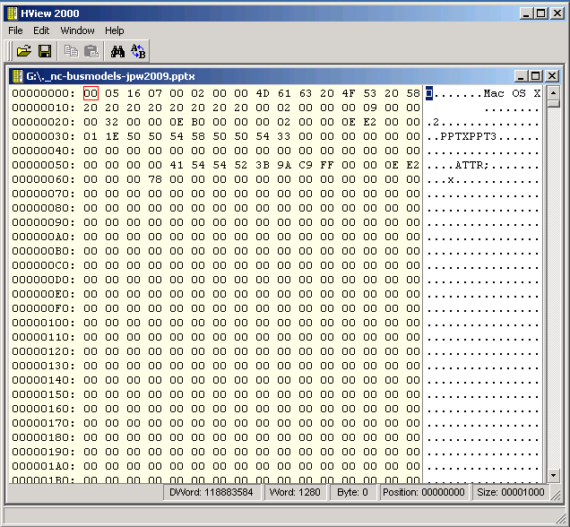
Interaction Examples
Level | Examples
Aggregation of objects | Browsing the contents of an archival collection using a finding aid
Object or package | Viewing a web page that contains several files, including HTML, a style sheet and several images
In-application rendering | Using Microsoft Excel to view an .xls file, watching an online video by using a Flash viewer
File through filesystem | Viewing contents of a folder using Windows Explorer, typing “ls” at the Unix command prompt to show the contents of a directory
File as “raw” bitstream | Opening an individual file in a hex editor
Sub-file data structure | Extracting a tagged data element in an XML document or value of a field in a relational database
Bitstream through I/O equipment | Connecting a hard drive to a host computer and then generating a sector-by-sector image of the disk using Unix dd command
Raw signal stream through I/O equipment | Connecting a floppy drive to a host computer and then generating a magnetic flux transition image of the disk
Bitstream on physical medium | Using a high-power microscope and camera to take a picture of the patterns of magnetic charges on the surface of a hard drive or pits and lands on an optical disk

Slide 21
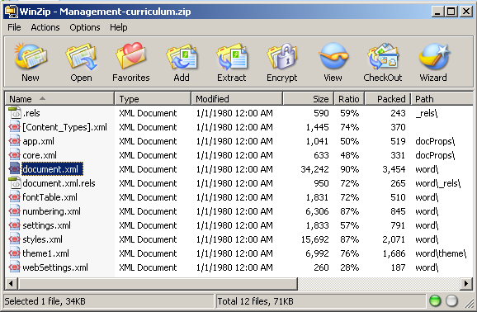
Interaction Examples
Level | Examples
Aggregation of objects | Browsing the contents of an archival collection using a finding aid
Object or package | Viewing a web page that contains several files, including HTML, a style sheet and several images
In-application rendering | Using Microsoft Excel to view an .xls file, watching an online video by using a Flash viewer
File through filesystem | Viewing contents of a folder using Windows Explorer, typing “ls” at the Unix command prompt to show the contents of a directory
File as “raw” bitstream | Opening an individual file in a hex editor
Sub-file data structure | Extracting a tagged data element in an XML document or value of a field in a relational database
Bitstream through I/O equipment | Connecting a hard drive to a host computer and then generating a sector-by-sector image of the disk using Unix dd command
Raw signal stream through I/O equipment | Connecting a floppy drive to a host computer and then generating a magnetic flux transition image of the disk
Bitstream on physical medium | Using a high-power microscope and camera to take a picture of the patterns of magnetic charges on the surface of a hard drive or pits and lands on an optical disk

Slide 22
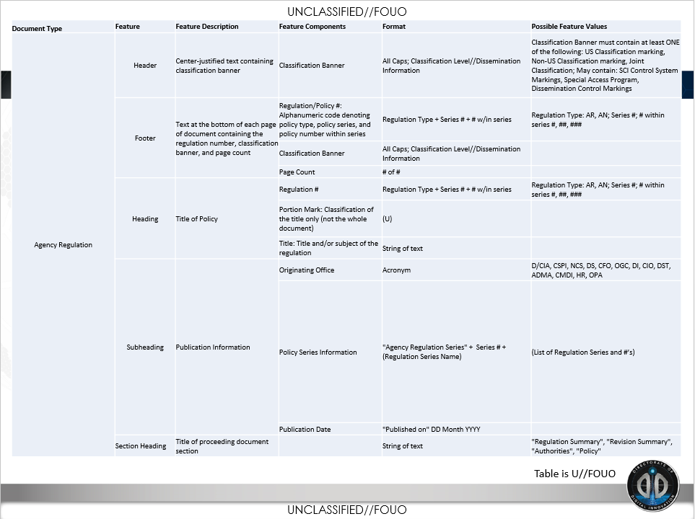
Source: Kathy Sobolewski, “Information Management Services: Machine Learning Briefing to UNC Chapel Hill,” 2016.

Slide 23
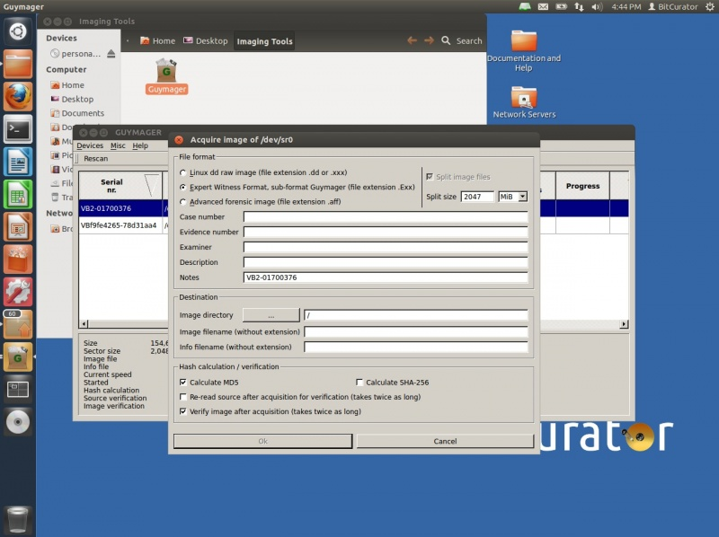
Interaction Examples
Level | Examples
Aggregation of objects | Browsing the contents of an archival collection using a finding aid
Object or package | Viewing a web page that contains several files, including HTML, a style sheet and several images
In-application rendering | Using Microsoft Excel to view an .xls file, watching an online video by using a Flash viewer
File through filesystem | Viewing contents of a folder using Windows Explorer, typing “ls” at the Unix command prompt to show the contents of a directory
File as “raw” bitstream | Opening an individual file in a hex editor
Sub-file data structure | Extracting a tagged data element in an XML document or value of a field in a relational database
Bitstream through I/O equipment | Connecting a hard drive to a host computer and then generating a sector-by-sector image of the disk using Unix dd command
Raw signal stream through I/O equipment | Connecting a floppy drive to a host computer and then generating a magnetic flux transition image of the disk
Bitstream on physical medium | Using a high-power microscope and camera to take a picture of the patterns of magnetic charges on the surface of a hard drive or pits and lands on an optical disk

Slide 24
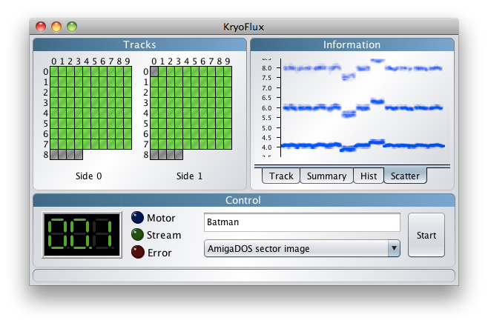
Interaction Examples
Level | Examples
Aggregation of objects | Browsing the contents of an archival collection using a finding aid
Object or package | Viewing a web page that contains several files, including HTML, a style sheet and several images
In-application rendering | Using Microsoft Excel to view an .xls file, watching an online video by using a Flash viewer
File through filesystem | Viewing contents of a folder using Windows Explorer, typing “ls” at the Unix command prompt to show the contents of a directory
File as “raw” bitstream | Opening an individual file in a hex editor
Sub-file data structure | Extracting a tagged data element in an XML document or value of a field in a relational database
Bitstream through I/O equipment | Connecting a hard drive to a host computer and then generating a sector-by-sector image of the disk using Unix dd command
Raw signal stream through I/O equipment | Connecting a floppy drive to a host computer and then generating a magnetic flux transition image of the disk
Bitstream on physical medium | Using a high-power microscope and camera to take a picture of the patterns of magnetic charges on the surface of a hard drive or pits and lands on an optical disk

Slide 25
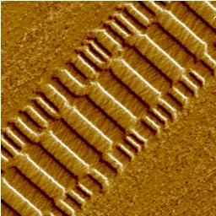
Interaction Examples
Level | Examples
Aggregation of objects | Browsing the contents of an archival collection using a finding aid
Object or package | Viewing a web page that contains several files, including HTML, a style sheet and several images
In-application rendering | Using Microsoft Excel to view an .xls file, watching an online video by using a Flash viewer
File through filesystem | Viewing contents of a folder using Windows Explorer, typing “ls” at the Unix command prompt to show the contents of a directory
File as “raw” bitstream | Opening an individual file in a hex editor
Sub-file data structure | Extracting a tagged data element in an XML document or value of a field in a relational database
Bitstream through I/O equipment | Connecting a hard drive to a host computer and then generating a sector-by-sector image of the disk using Unix dd command
Raw signal stream through I/O equipment | Connecting a floppy drive to a host computer and then generating a magnetic flux transition image of the disk
Bitstream on physical medium | Using a high-power microscope and camera to take a picture of the patterns of magnetic charges on the surface of a hard drive or pits and lands on an optical disk
Veeco Instruments. http://www.veeco.com/library/nanotheater_detail.php?type=application&id=78&app_id=34

Slide 26
Stepping Above the Bits – Representation Information

Slide 27
Representation Considerations
Representation and interpretation are complementary – interpretation depends on representation
Can have multiple interpretations of same representation, but...
Some representation schemes make certain transformations and uses easier than others

Slide 28
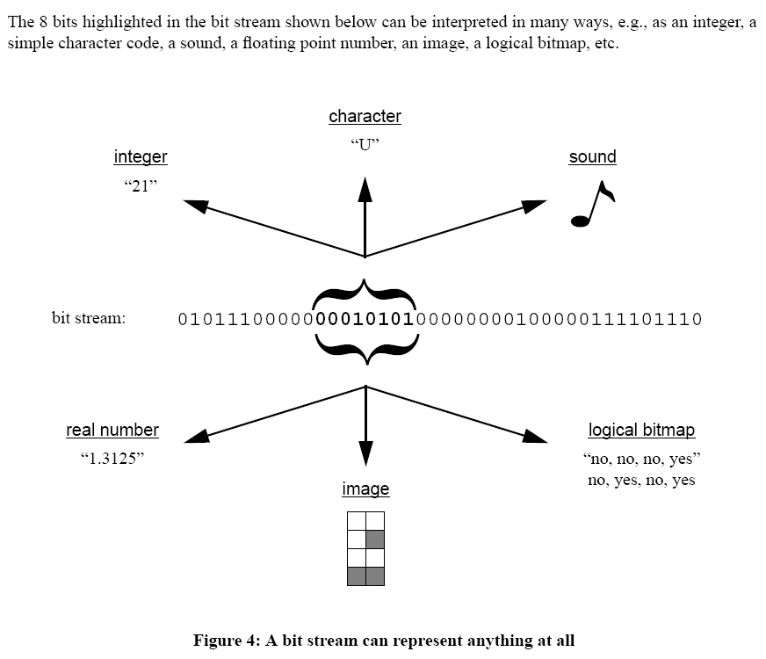
Rothenberg, Jeff. "Ensuring the Longevity of Digital Information." Washington, DC: Council on Library and Information Resources, 1999.

Slide 29
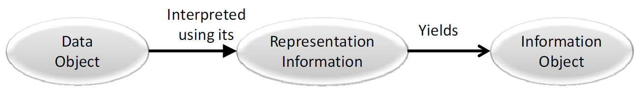
Representation Information
“Information that maps a Data Object into more meaningful concepts” (OAIS) - makes humanly-perceptible properties happen
Examples: file format, encoding scheme, data type
Reference Model for an Open Archival Information System (OAIS). CCSDS 650.0-M-2 (Magenta Book). Consultative Committee for Space Data Systems, 2012. [ISO 14721:2012]. Figure 2-2.

Slide 30
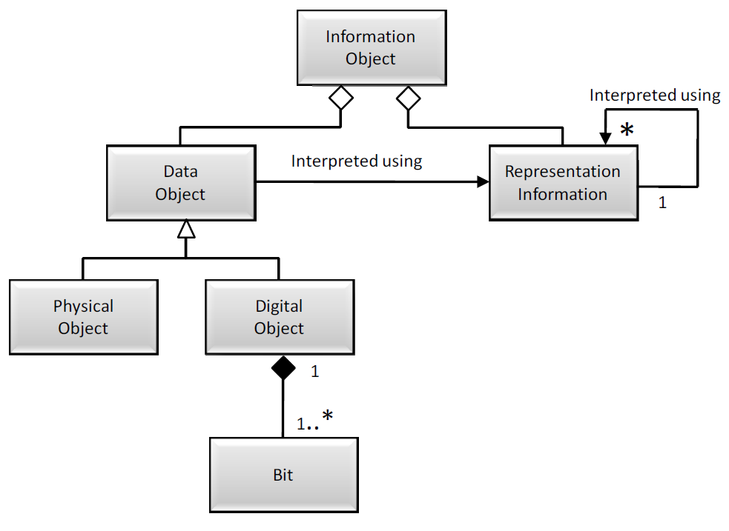
Reference Model for an Open Archival Information System (OAIS). CCSDS 650.0-M-2 (Magenta Book). Consultative Committee for Space Data Systems, 2012. [ISO 14721:2012]. Figure 4-10.

Slide 31
Reference Model for an Open Archival Information System (OAIS). CCSDS 650.0-M-2 (Magenta Book). Consultative Committee for Space Data Systems, 2012. [ISO 14721:2012]. Figure 4-10.

Slide 32
A Simple Example of Making Sense of a Bit Stream

Slide 33
00111100011101000110100101110100011011000110010100111110001001100111010101110101011011010110110001010101

Slide 34
Hint: These are Bytes 00111100 01110100 01101001 01110100 01101100 01100101 00111110 00100110 01110101 01110101 01101101 01101100 01010101

Slide 35
Add Byte-Level Encoding Knowledge: This is ASCII <title>&Uuml;

Slide 36
Add Data Structure Knowledge: This is HTML So text is intended to be a document title

Slide 37
Add further character encoding knowledge: HTML supports ISO 8859-1 character entities &Uuml; = “latin capital letter U with diaeresis”

Slide 38
Add character rending (font) information: Using Arial font, “latin capital letter U with diaeresis” can be rendered as the following glyph: Ü

Slide 39
Things will often be much messier than the previous example. Some complication factors...

Slide 40
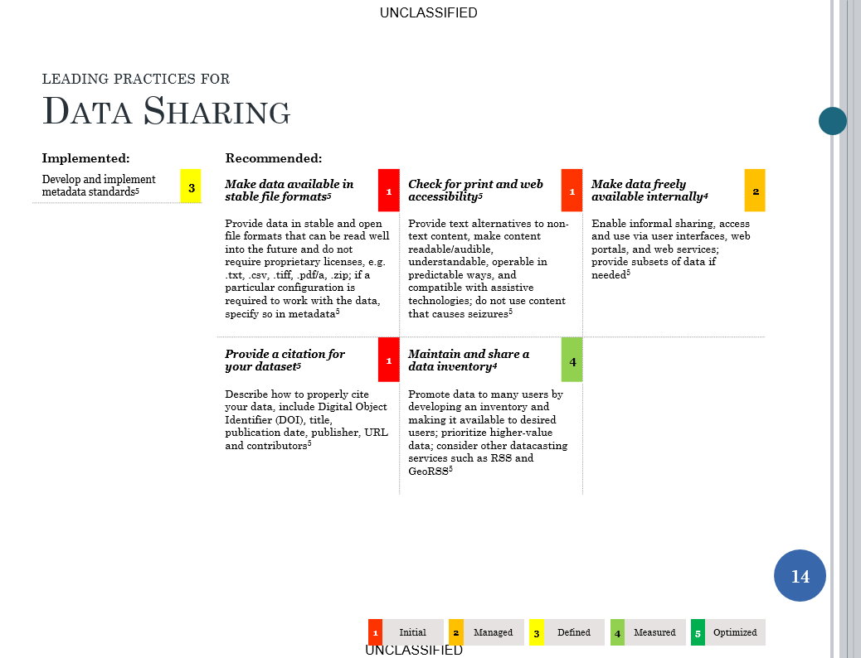
Source: Data Management Leading Practices. OSC, 6/26/2015

Slide 41
Source: Data Management Leading Practices. OSC, 6/26/2015

Slide 42
Formats that are proprietary or otherwise not sufficiently documented.

Slide 43
Compression

Slide 44
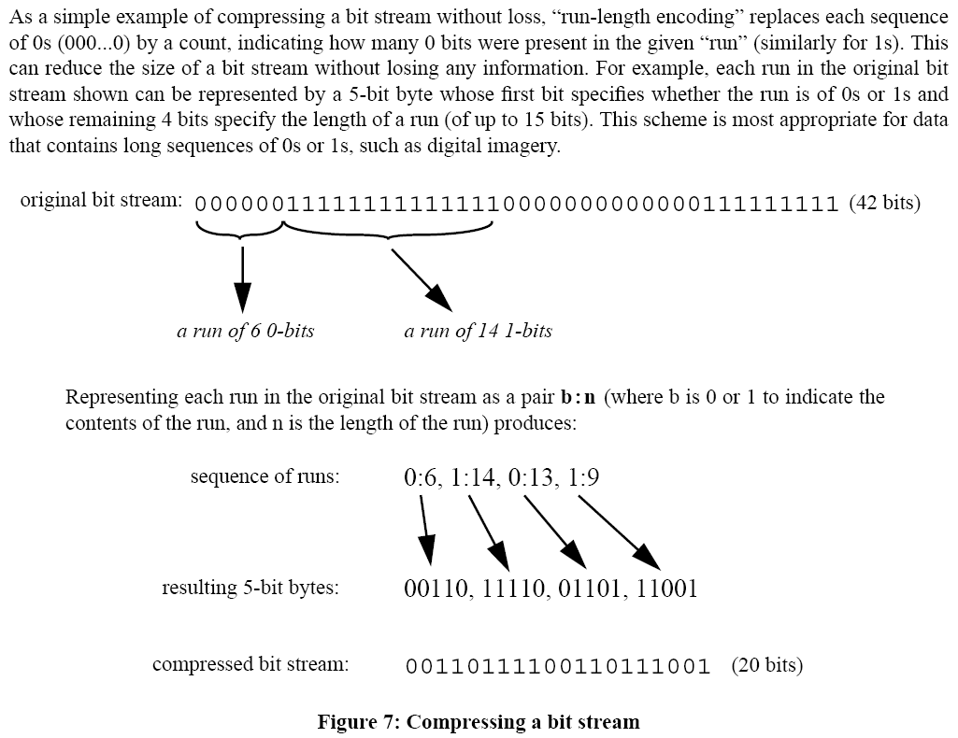
Rothenberg, Jeff. "Ensuring the Longevity of Digital Information." Washington, DC: Council on Library and Information Resources, 1999.

Slide 45
Three Levels of Compression*
Format of file implements compression internally - e.g. body of JPEG file is compressed but not file header
Application creates completely new, compressed copy of file(s) – e.g. WinZip, gzip
File system compresses data units – e.g. not writing data to series of sectors that are all filled with zeros
*Carrier, Brian. File System Forensic Analysis. Boston, MA: Addison-Wesley, 2005.

Slide 46
Encryption
Special data (“keys”) and algorithms used to transform data into a form that is purposely less easy to read
Used for:
Confidentiality
Integrity
Non-repudiation
Authentication

Slide 47
Encryption at Various Levels*
Application that creates the file
Application that reads an unencrypted file and creates an encrypted file
Operating System – “Before a file is written to disk, the OS encrypts the file and saves the cipher text to the data units. The non-content data, such as the file name and last access time, are typically not encrypted. The application that wrote the data does not know the file is encrypted on the disk.”
Encrypt an entire volume – implemented in storage system below file system level
*Carrier, Brian. File System Forensic Analysis. Boston, MA: Addison-Wesley, 2005.

Slide 48
Robustness of File Formats*
Image compression is specifically designed to remove a certain form of redundancy (that which is presumed to be imperceptible or irrelevant to a user of the image)
Header information can help to make sense of corrupted portions of a file
Can be very helpful to also store header information outside of the file – corruption of header can otherwise seriously inhibit use of file
More serialized formats – e.g. XML rather than a binary format – usually easier to recover (in whole or in part) after data errors
*We’ll have an exercise on this later.

Slide 49
Obsolescence
"Those who forget the past are condemned to reload it."
- Nick Montfort, July 2000
All layers undergo change over time, at varying rates.

Slide 50
What is “Long Term”?
“A period of time long enough for there to be concern about the impacts of changing technologies, including support for new media and data formats, and of a changing Designated Community, on the information being held in an OAIS.”
Reference Model for an Open Archival Information System (OAIS). CCSDS 650.0-M-2 (Magenta Book). Consultative Committee for Space Data Systems, 2012. [ISO 14721:2012]. Page 1-12.

Slide 51
Risks Associated with Obsolescence
Vendor Lock-In
Legacy Data
Need for “Digital Archeology” (more about this tomorrow)

Slide 52
Approaches to Preserving Layers of Meaning
Make information useful
Policies and procedures (periodically revisited and audited)
Creators’ and users’ awareness of issues
System development
System administration
Ongoing maintenance - copying, converting, reformatting, emulating, normalizing, migrating

Slide 53
Significant Properties
“Whoever takes the decision that a particular digital object should be preserved will have to decide what properties are to be regarded as significant. The submission agreement could usefully specify a list of significant properties.” (CEDARS)¹
“properties of digital objects that affect their quality, usability, rendering, and behaviour” (CAMiLEON)²
Essence = “characteristics that must be preserved for the record to maintain its meaning over time”³
1. Holdsworth, David, and Derek M. Sergeant. "A Blueprint for Representation Information in the OAIS Model." Paper presented at the IEEE Symposium on Mass Storage Systems, College Park, Maryland, USA, March 27-30, 2000.
2. Hedstrom, Margaret, and Christopher A. Lee. "Significant Properties of Digital Objects: Definitions, Applications, Implications." In Proceedings of the DLM-Forum 2002, Barcelona, 6-8 May 2002: @ccess and Preservation of Electronic Information: Best Practices and Solutions, 218-27. Luxembourg: Office for Official Publications of the European Communities, 2002.
3. Heslop, Helen, Simon Davis, and Andrew Wilson. "An Approach to the Preservation of Digital Records." National Archives of Australia, 2002.

Slide 54
Defining Significant Properties can Serve a Variety of Purposes
Writing specific provisions into submission agreements
Developing criteria & empirical tools for evaluating preservation approaches
Documentation of preservation decisions in terms of specific properties
allowing professionals to revisit previous decisions
indicating to researchers what properties have not been retained

Slide 55
Traditional Dichotomy: Emulation vs. Transformation/Migration
Emulation – Use of software to imitate obsolete computer equipment on new computer equipment, i.e. trick files and applications into thinking they’re still running in their original environment
Transformation/Migration – Digital object that depends on obsolete computer equipment is changed in order to run directly on new equipment
Advocates of emulation contend that it better supports notion of preserving an “original,” along with its “look and feel,” and it can be more cost-effective than repeated transformations of digital objects
Notes:
Transformation is also often called migration or transformative migration.

Slide 56
Emulation
“To reproduce the action of or behave like (a different type of computer) with the aid of hardware or software designed to effect this; to run (a program, etc., written for another type of computer) by this means.”
Source: Oxford English Dictionary, Second Edition.

Slide 57
Migration
Periodic transformation of the bits/bytes to run directly on newer platforms.
Used widely as an approach to actively managing legacy systems.
Work can be expensive and introduce errors of translation.
Since the resulting objects can run directly on newer platforms, layers of technology can be minimized.

Slide 58
Not Just “Emulation vs. Migration”
All strategies use standards in some way
General consensus to keep original bits
Transformation can be minor or extensive
Transformation/Emulation can take place in Producer environment, upon Ingest, as part of preservation activities within a repository, or at time of access

Slide 59
Cost-Benefit Analysis of a Preservation Approach
Cost = sum of all resources one must commit in order to carry it out
Benefits = value one can derive from the digital objects that have been preserved based on that approach
Opportunity costs = failure to derive benefits that one could have had by choosing a different approach

Slide 60
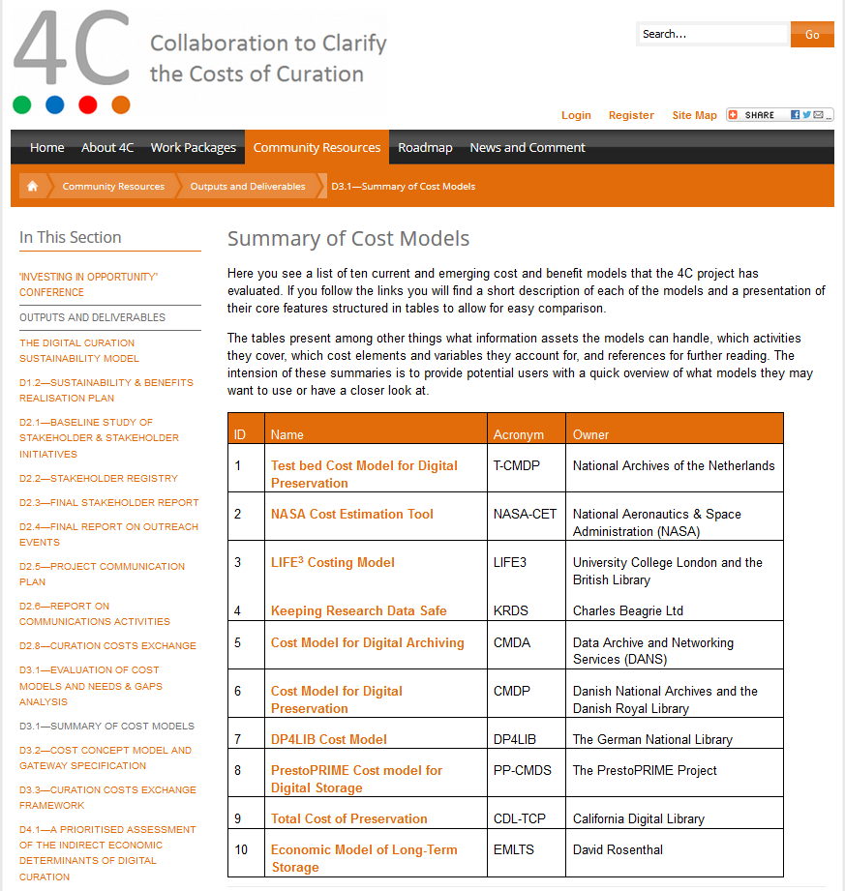
http://4cproject.eu/summary-of-cost-models

Slide 61
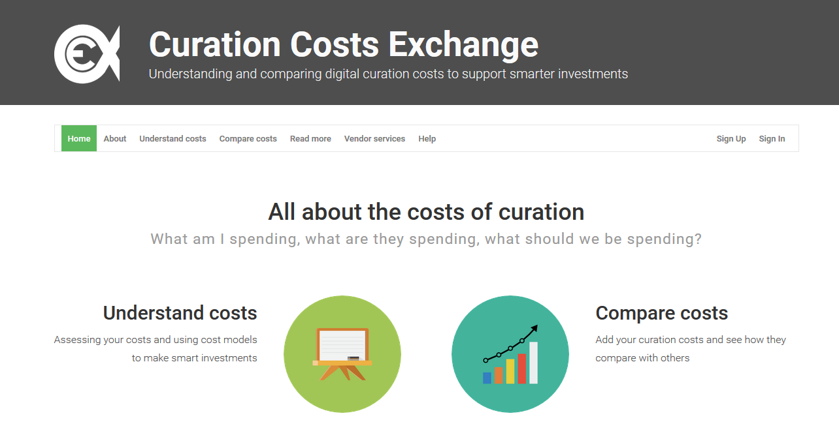
http://www.curationexchange.org/

Slide 62
Using Properties in Making Guesses about Benefits
Impossible to directly measure now the value of future use, so we must guess as to their expected value.
Users derive value from digital objects by performing various high-level functions.
Properties that facilitate those functions should have instrumental value.
One would hope to preserve properties that serve the widest possible range of uses, though one may weigh some types of use more heavily than others.

Slide 63
Punch Line 1: No Such Thing as Benign Neglect
Ongoing preservation effort is assumed, regardless of the strategy adopted.
Goal is to minimize (rather than eliminate) work and maximize the benefits.

Slide 64
Punch Line 2: Identify What’s Desirable & What’s Possible
Best, most informed guess about how objects will be used
Characteristics that support such use
Currently available technical approaches
Whether using any given approach can cost-effectively preserve those characteristics
All decisions should be well-documented and revisited periodically

Slide 65
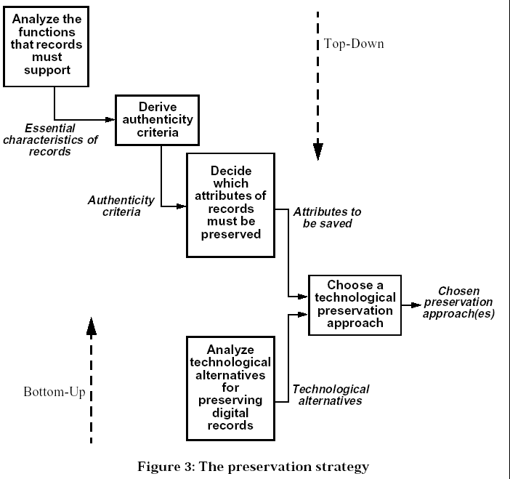
Source: Jeff Rothenberg and Tora K. Bikson, "Carrying Authentic, Understandable and Usable Digital Records through Time", 1999

Slide 66
Digital preservation is not an all-or-nothing proposition.

Slide 67
Categories of Service
Categories of contributors or content types that carry similar set of promises for:
Amount of work before and during accession process
Validation
Creation of metadata and documentation
Intellectual property protection
Security
Access Controls
Long-term preservation of content, contextual information, structure, behavior

Slide 68
Factors Defining Categories
Institutional arrangements and agreements
Scope and policies for appraisal and collection development
Complexity of digital objects and relationships
Significant properties of objects and relationships
File formats: availability of documentation of formats, openness and industry support
Availability and sustainability of:
Technical resources (hardware, software, systems)
Human resources (attention and expertise)

Slide 69
Access and Use Considerations

Slide 70
Many More Decisions about Levels of Investment (Recall Categories of Service from Earlier)
How much to pre-process content vs. simply giving the bits to the users
For digitized materials:
OCR or not
Page turner vs. page-level access
Quality control for access copies
For data sets:
“FTP-style” download of whole files vs. specialized API for manipulation/analysis vs. hosting and providing manipulation/analysis services vs. one unified user interface
For collections of web pages:
Static or dynamic rewriting of links vs. presenting as collected
Full-text search vs. only URL-based access
User interface that clearly distinguishes archived from live content vs. presenting as collected

Slide 71
Digital Resources
Aggregation
Object
In-application rendering
File through filesystem
File as bitstream
Sub-file data structure
Bitstream though I/O
Signal stream through I/O
Bitstream on medium
Access and Use
Levels of Representation
= Potential paths of interaction
*Recall these layers from earlier

Slide 72
Source: Data Management Leading Practices. OSC, 6/26/2015

Slide 73
What is an Identifier?*
“A stated association between a symbol and a thing; that the symbol may be used to unambiguously refer to the thing within a given context."
“...an identifier will only exist as long as anyone remembers the declaration of association. Persistence of identifiers is not so much about remembering the identifier itself, but what it is associated with."
*Campbell, Douglas. "Identifying the Identifiers." Paper presented at the International Conference on Dublin Core and Metadata Applications, Singapore, August 27-31, 2007.

Slide 74
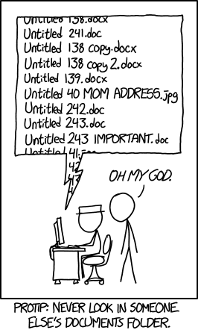
http://xkcd.com/1459/

Slide 75
Uses for Identifiers
Discovery – finding the object identified
Retrieval – getting the object identified
Citation – telling others about the object identified
As surrogate for object itself - store the identifier, not the whole object

Slide 76
Accessing Digital Information
Three main ways:
Where it is
What it contains
What is said about it
Real systems often involve a combination of the above

Slide 77
Where it is – Going to specific location
Pros:
fast retrieval
easy to implement
path to location can often provide hints about meaning (e.g. “finance-committee/2008/minutes”)
Cons:
pointers often must be updated to reflect location changes
access often dependent on specific way that storage is implemented
hierarchical systems usually place each object in only one place, thus reifying a single path to the object that may lose relevance over time

Slide 78
What it contains – Searching across contents of files themselves
Pros:
can serve as “stop-gap” approach when other mechanisms aren’t available
can often reveal information that wouldn’t have been visible otherwise (e.g. search term that never appeared in an index)
Cons:
very slow to do a serial search over all content
often very low precision of results
no intellectual control (e.g. authority control)

Slide 79
What is said about it – Use of surrogates
Various data values serve as access points to the object (e.g. title, checksum, file name)
Finding an object requires either (1) a single access point or (2) combination of access points, that uniquely identify the object
Access point or set of access points that are unique in one context may not be unique in another context, e.g.
calling someone only by her first name usually works within your family but doesn’t work in a government database
file name of Untitled.doc on your computer will be unique within a given folder, because operating system prevents you from using the same name twice within a folder, but there could be many Untitled.doc files in other folders
Implications of this...

Slide 80
Relying on External Surrogates to Get to Objects
Pros:
Object can have an arbitrarily large number of identifiers, which can be optimized for different purposes
Massive performance gains, e.g. searching over index of a database, rather than serial search over data directly
Integrity & access controls better managed when finding doesn’t require reading object’s data directly
Cons:
Surrogate creation, management & exposure to the outside world has to be done right!

Slide 81
Think Globally, Name Locally
Many existing mechanisms for assigning persistent IDs, generally all based on:
Conventions for generating strings of text that are unique within a given domain
Syntax for identifying the ID system used and domain
System for resolving persistent ID to more direct path within a storage or file system
Can use whatever system is most appropriate in local context, but must have ability to qualify that name for use outside the local context
Namespaces – context within which an ID/name is applied to a given object (e.g. dc:title indicates that title is being used as that element is defined within Dublin Core namespace)

Slide 82
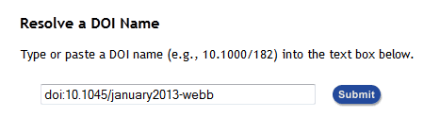
Example: DOI
doi:10.1045/january2013-webb
Visit: http://www.doi.org/
And…
http://dx.doi.org/10.1045/january2013-webb
http://www.dlib.org/dlib/january13/webb/01webb.html

Slide 83
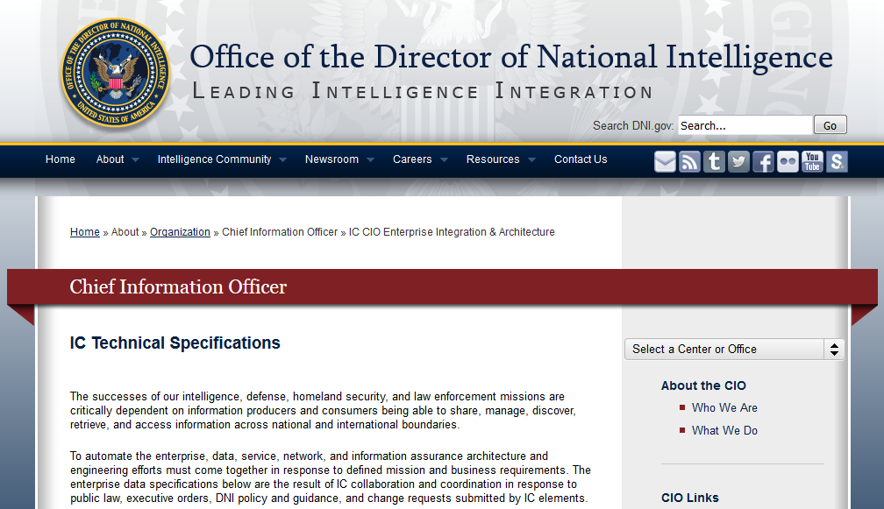
Example: PURL
http://purl.org/IC/Standards/public
https://www.dni.gov/index.php/about/organization/chief-information-officer/ic-cio-enterprise-integration-architecture

Slide 84
Factors in ID Persistence
Sustainability of the system and/or its administering organisation(s): an identifier issued by an organisation which has questionable sustainability has limited credibility as a persistent identifier.
Popularity of the system: if a PID service, and the technologies and rules underpinning it, are widely adopted and understood, then a community with an interest in the long-term sustainability of the PID scheme will be formed.
Quality of system documentation: the PID system must be well documented if it is to be understood and implemented over time.
Standards compliance: compliance with web standards, such as URI, can bring interoperability and transparency.
Low cost or free: a repository responsible for preserving digital archives and manuscripts will use a great many PIDs, it is therefore highly desirable that any PID system is economic to administer.
Independent of, but interoperable with, other systems: PIDs must outlast all systems. When repository systems and storage technologies are upgraded, PIDs must remain consistent.
Ability to incorporate existing identification schemes: if there is a long-established persistent identifier scheme already in use within an institution or particular sector, it might be useful to incorporate these identifiers into the namespace of whatever PID system is adopted for the electronic environment (an example might be ISBN identifiers for books).
Source: Thomas, Susan, Renhart Gittens, Janette Martin, and Fran Baker. "Workbook on Digital Private Papers." 2007. p.52 [PARADIGM Workbook]

Slide 85
Identification Depends on Socio-Technical Systems – Not Just Specific Names or Software
“…technology is not sufficient to guarantee persistence: if anything, depending on particular technologies ends up getting in the way of persistence. Guaranteeing persistence of identifiers depends much more on cogent policies to make sure that someone keeps assets online and links up to date, over a well-defined period. It is just as important to be seen as having cogent policies, as to have them: the proper goal of persistence is to establish user trust in using the identifiers.”
*Nicholas, Nick, Nigel Ward, and Kerry Blinco. "A Policy Checklist for Enabling Persistence of Identifiers." D-Lib Magazine 15, no. 12 (2009). (Emphasis added)

Slide 86
Persistent Identifier Linking Infrastructure (PILIN) Project*
“Persistence is always the persistence of some property of the identifier.”
Properties of an identifier which can be persistent:
Name
Association of identifier to thing
“Applicability of a service on an identifier. The URI http://www.libertymatters.org/flyers.htm is no longer resolvable, so the retrieval service for the identifier has not persisted, even though its association has.”
Accountability of an identifier, i.e. “who is responsible for updating an identifier and who has created it”
*Nicholas, Nick, Nigel Ward, and Kerry Blinco. "A Policy Checklist for Enabling Persistence of Identifiers." D-Lib Magazine 15, no. 12 (2009). (Emphasis in original)

Slide 87
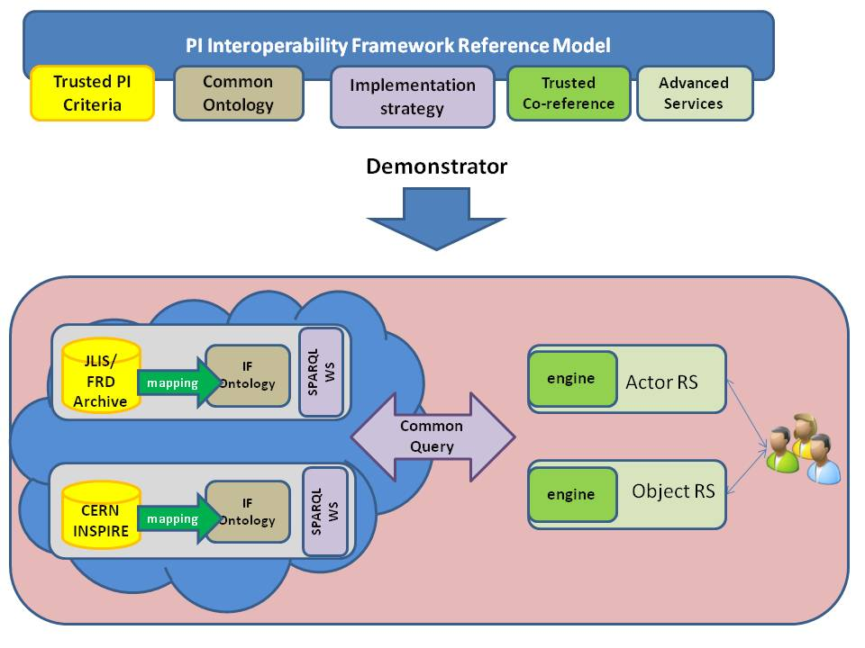
Interoperability Framework for Persistent Identifiers (APARSEN Project)
Goal: “model for interoperability at service level among existing PI systems without interfering with their internal organisation and policies”
Demonstrator: http://93.63.166.138/demonstrator/demo7/

Slide 88
File Naming Decision – Human-Readable vs. Opaque
What are the advantages of human-readable file naming?
Examples of file names that would be effective in being used by humans?
What are the disadvantages of human-readable file naming?*
*See: Willett, Perry. “NOID: Nice Opaque Identifier (Minter and Name Resolver).” 2006. https://confluence.ucop.edu/display/Curation/NOID

Slide 89
Digital Resources to be Identified
Bitstreams
Larger packages (aggregation of bitstreams and metadata)
Metadata
Special case: File format information, e.g. PRONOM Unique ID (PUID)

Slide 90
What is the Documentary Unit?
Functional Requirements for Bibliographic Records (FRBR): work, expression, manifestation, item
COUNTER
Defines: article, book, chapter, collection, database, database record, entry, full-text article, item, journal, section, title, volume
HTML & PDF copies of a single work treated as two different uses
Files associated with a web version (e.g. GIF images, style sheets) not counted

Slide 91
The Reality of Getting to Digital Objects
Usually involves combination or hybrid of all 3 types of access
Examples:
Checksum as access point – can be stored within file or outside of it, but in both cases is based on content of file itself (as opposed to externally imposed descriptor)

Slide 92
Citation Standard for Data Sets (Dataverse Network Project)*
Replication data-set citation example (six components):
*http://thedata.org/citation

Slide 93
Gary King; Langche Zeng, 2006, "Replication Data Set for 'When Can History be Our Guide? The Pitfalls of Counterfactual Inference'" hdl:1902.1/DXRXCFAWPK UNF:3:DaYlT6QSX9r0D50ye+tXpA== Murray Research Archive [distributor]

Slide 94
Gary King; Langche Zeng, 2006, "Replication Data Set for 'When Can History be Our Guide? The Pitfalls of Counterfactual Inference'" hdl:1902.1/DXRXCFAWPK UNF:3:DaYlT6QSX9r0D50ye+tXpA== Murray Research Archive [distributor]
Author(s)

Slide 95
Gary King; Langche Zeng, 2006, "Replication Data Set for 'When Can History be Our Guide? The Pitfalls of Counterfactual Inference'" hdl:1902.1/DXRXCFAWPK UNF:3:DaYlT6QSX9r0D50ye+tXpA== Murray Research Archive [distributor]
Year

Slide 96
Gary King; Langche Zeng, 2006, "Replication Data Set for 'When Can History be Our Guide? The Pitfalls of Counterfactual Inference'" hdl:1902.1/DXRXCFAWPK UNF:3:DaYlT6QSX9r0D50ye+tXpA== Murray Research Archive [distributor]
Title

Slide 97
Gary King; Langche Zeng, 2006, "Replication Data Set for 'When Can History be Our Guide? The Pitfalls of Counterfactual Inference'" hdl:1902.1/DXRXCFAWPK UNF:3:DaYlT6QSX9r0D50ye+tXpA== Murray Research Archive [distributor]
Unique global identifier (handle)

Slide 98
Gary King; Langche Zeng, 2006, "Replication Data Set for 'When Can History be Our Guide? The Pitfalls of Counterfactual Inference'" hdl:1902.1/DXRXCFAWPK UNF:3:DaYlT6QSX9r0D50ye+tXpA== Murray Research Archive [distributor]
Universal Numerical Fingerprint (UNF)
Based on a one-way algorithm applied to the data content*, designed to be independent of file format of the data
*Normalize values in various ways, encode as UTF-8 strings, then apply SHA256 hashing

Slide 99
Gary King; Langche Zeng, 2006, "Replication Data Set for 'When Can History be Our Guide? The Pitfalls of Counterfactual Inference'" hdl:1902.1/DXRXCFAWPK UNF:3:DaYlT6QSX9r0D50ye+tXpA== Murray Research Archive [distributor]
Distributor (optional) = network type (based on a controlled vocabulary)

Slide 100
Gary King; Langche Zeng, 2006, "Replication Data Set for 'When Can History be Our Guide? The Pitfalls of Counterfactual Inference'" hdl:1902.1/DXRXCFAWPK UNF:3:DaYlT6QSX9r0D50ye+tXpA== Murray Research Archive [distributor]
When in print, also provide URL

Slide 101
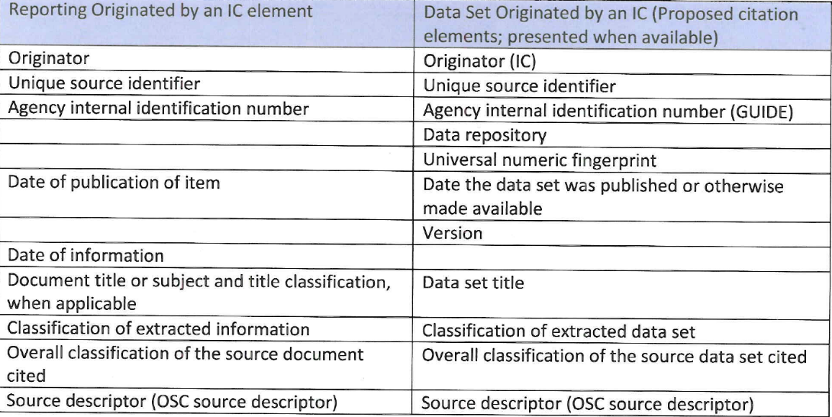
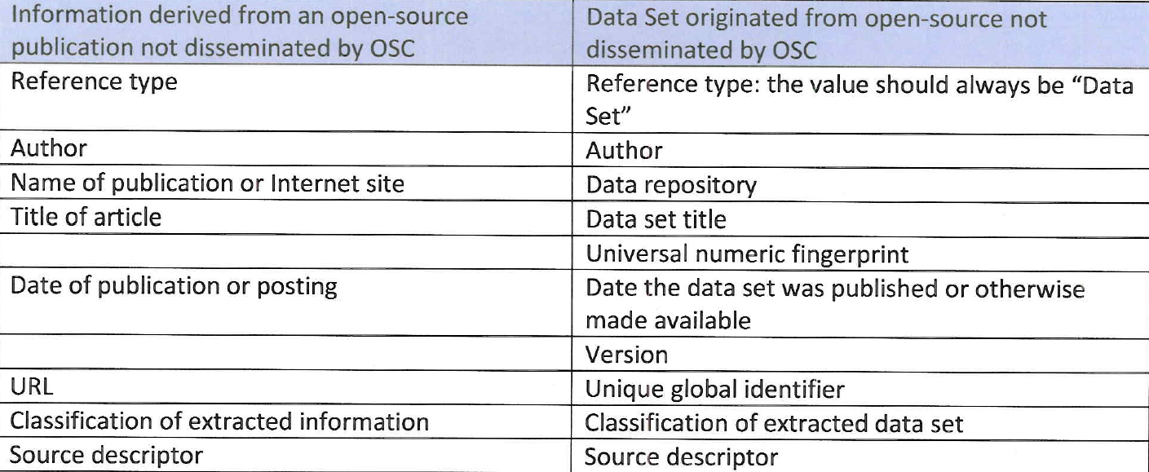
OSC Standard Source Citations Mapped to Elements Required in IC Directive 206
*Intelligence Community Directive Number 206. “Sourcing Requirements For Disseminated Analytic Products.” Effective: October 17, 2007.

Slide 102
OSC Standard Source Citations Mapped to Elements Required in IC Directive 206
*Intelligence Community Directive Number 206. “Sourcing Requirements For Disseminated Analytic Products.” Effective: October 17, 2007.

Slide 103
Difficulties of Determining Use of Digital Resources

Slide 104
Technical Layers Between User & Document
Dynamic allocation of IP address to user’s computer
Proxy servers – server through which a user can connect to network services, rather than connecting directly
Cached copies – saved closer to the user to reduce bandwidth demand & download time
Aggregators – host, deliver & get paid for content
Gateways – doesn’t store, but refers users to content or submits requests on their behalf
Access controls – can result in “turnaways” (rejected sessions)
User name – not always traceable to a person
User must click on something, which can result in double-clicks

Slide 105
Organizational and institutional layers
Consortium (expressed as range of IP addresses)
Consortium member (generally an organization and expressed as subset of the above range of IP addresses)
Organizational units & individuals within consortium member

Slide 106
Ways to Identify a Persistent User
IP address or address range
Host name
Session cookie
User cookie
User name (log in)

Slide 107
How Does this Fit into the Information Seeking Process?
Server stats show only a tiny slice into the information seeking process
Can fail to capture:
Determination of original information need
Interactions with other people
Use of other documents
Use of search engines
Navigation to the library’s site
Use of the document (e.g. viewing, printing, sharing, copying, annotating)

Slide 108
What is the Documentary Unit?
Functional Requirements for Bibliographic Records (FRBR): work, expression, manifestation, item
COUNTER
Defines: article, book, chapter, collection, database, database record, entry, full-text article, item, journal, section, title, volume
HTML & PDF copies of a single work treated as two different uses
Files associated with a web version (e.g. GIF images, style sheets) not counted
What are the comparable units of description IC data?

